Slide 1


UHF Radio Operations
Prepared by:
Department of Public Safety

Slide 2
Introduction
UHF = Ultra High Frequency
The system is comprised of repeaters, antennas & hand-held radios
Repeater locations at each Campus
Our frequency is registered with the Federal Communications Commission (FCC)

Slide 3
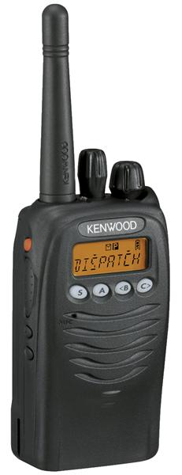
Kenwood TK-3173
UHF Compact Portable Radios
http://www.kenwoodusa.com/UserFiles/File/UnitedStates/Communications/LMR/Brochures/TK-3173.pdf

Slide 4
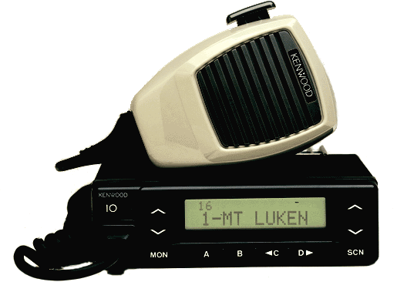
Kenwood TK-880
UHF FM Mobile Radio
http://www.kenwoodusa.com/UserFiles/File/Canada/Communications/AMA/Brochures/2007/TK-780-880.pdf

Slide 5
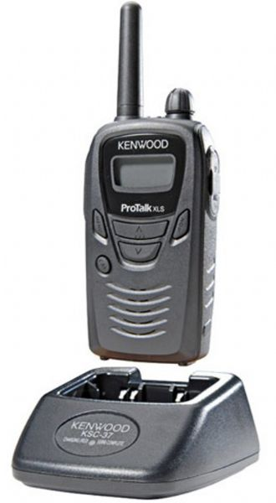
Battery Packs
LCD Battery Status Indicator
Low Battery Alert
Place Radio on Charger to Charge Battery
Red-Charging
Green- Complete

Slide 6
Transmission
Push to select channel using A, B, C buttons to
Wait for the channel to become clear to avoid interference
To maximize the readability of your transmitted signal, pause a few seconds after pushing PTT
Push and hold PTT, speak into the microphone
Release PTT to return to receive
Transmitting without an antenna may damage the transceiver

Slide 7
UHF Radio Channels
Channels at each Campus Location
Maintenance (CAN, CSM, SKY) Campus Only
Public Safety – Transmits & Receives Districtwide
Local 1 – Not Repeated. Campus Only
Local 2 – Not Repeated. Campus Only

Slide 8



PUBLIC SAFETY Channel
Use Public Safety Channel to hail Public Safety. They need to change channels to respond, so please be patient.
District All/VOIP
UPS (Uninterrupted Power Source) back up power.

Slide 9

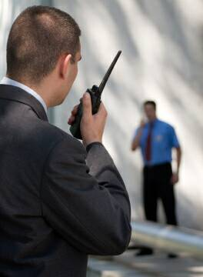
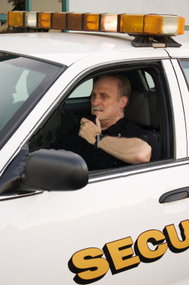
Who Has Radios?
Public Safety
Facilities
Administrators
EOCs
Campus Nurse
ITS
Bookstores
Children’s Center

Slide 10
FAQs
Filters on the repeater will filter out as much ‘outside’ chatter as possible
Radios ARE programmed to travel between campuses
UHF Radios have been identified for daily usage for Facilities & Public Safety. Also identified for primary usage during an emergency

Slide 11
Radio Etiquette
Do not ‘step-on’ or interrupt parties already engaged in conversation
Do not use for trivial or confidential conversations
As a courtesy, be aware of the volume of your radio; radios can be disruptive to those around you
Do not use foul language; the FCC considers this a grievous offense and will revoke our license

Slide 12
Radio Protocols
Before you talk, identify who you are trying to contact, then identify yourself and your college site
For Example: “CSM Public Safety this is Kathy Smith at CSM.”
Wait for a positive response & carry on your conversation
At the end of each piece of the conversation, prior to the other party’s response, indicate you are going to stop talking by saying ‘over’
When the last party to speak wants to end the conversation, indicate the end of transmission by saying ‘over’ or ‘clear’

Slide 13
Spelling Protocol
A=Adam
B=Boy
C=Charles
D=David
E=Edward
F=Frank
G=George
H=Henry
I=Ida
J=John
K=King
L=Lincoln
M=Mary
N=Nora
O=Ocean
P=Paul
Q=Queen
R=Robert
S=Sam
T=Tom
U=Union
W=William
X=X-ray
Y=Yellow
Z=Zebra

Slide 14
Personalized Radio Training
Public Safety Personnel are happy to provide personal radio training.
Feel free to drop by any DPS office or contact any DPS officer with questions or if you need assistance.

Slide 15
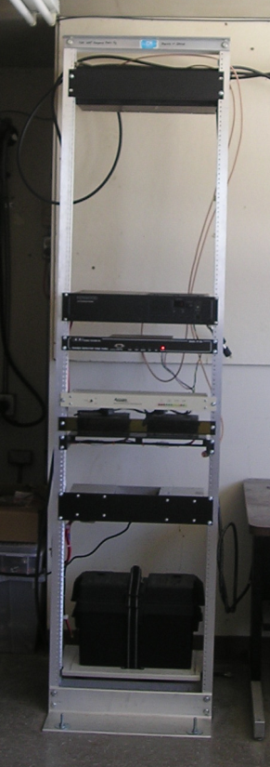
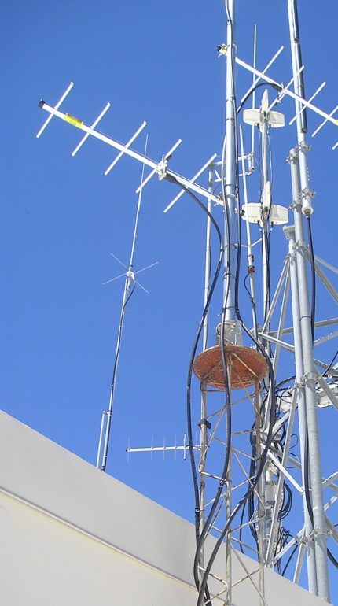
Questions & Answers

Slide 16
UHF Radio Operations
Prepared by:
Department of Public Safety
(650) 738-7000

