Slide 1
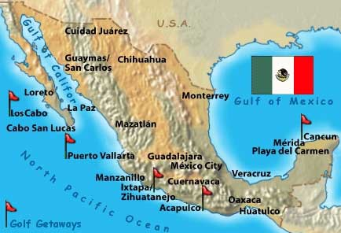
Mexico

Slide 2
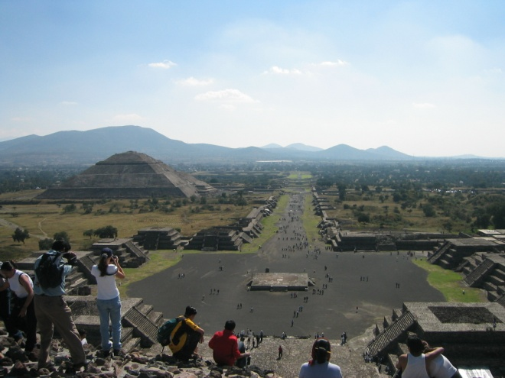
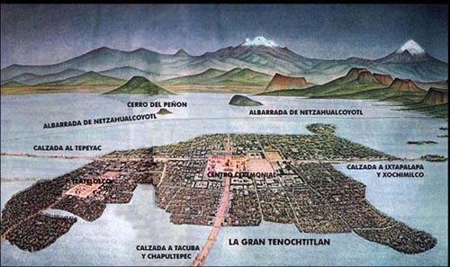
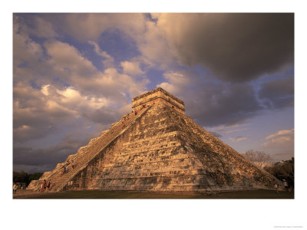
Pre-Columbian
5 major civilizations—Olmec, Teotihuacan, Maya, Toltec, Aztec (Mexica)

Slide 3
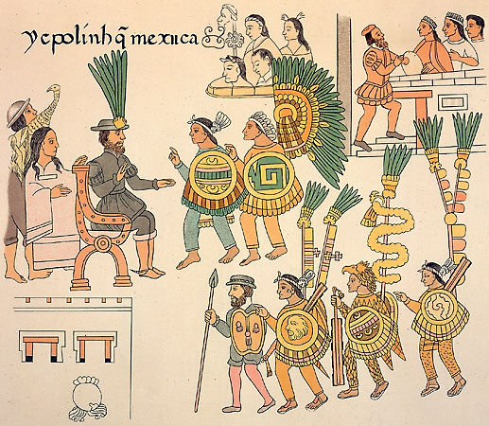
Conquest
1521 Cortes received as a divinity, with allies defeats Aztec emperors Moctezuma and Cuauhtemoc
All of Mexico subjugated over the next century and a half
Disease
Encomienda
Catholicism

Slide 4
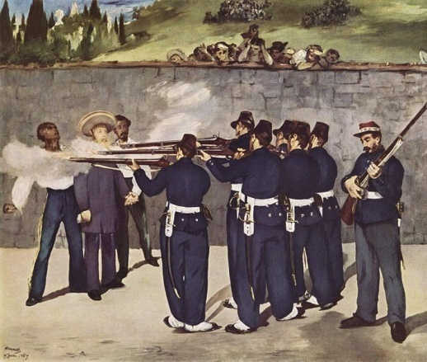
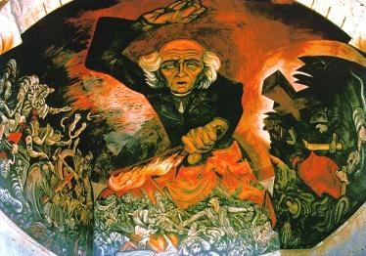
Independence
1810 first attempt—priests Hidalgo and Morelos rally forces behind the sign of the Virgin
1821 conservative elite declare independence to avoid liberalizing tendencies in Spain
1867 Mexicans defeat the French and their Austrian Emperor Maximilian

Slide 5
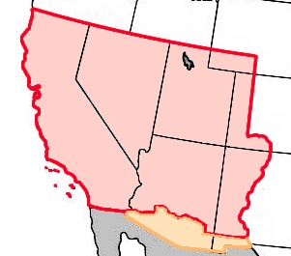
US role
1820s Americans settling in Texas
1836-45 Republic of Texas
1846-48 Mexican-American War

Slide 6
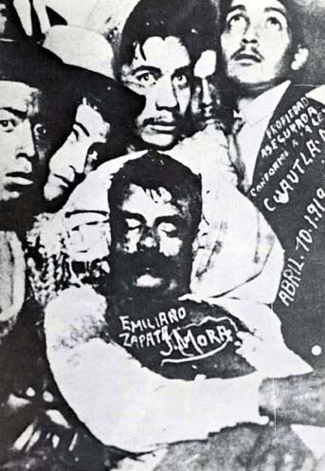
Revolution 1911-17
Porfirio Diaz attempt to hold on to power leads to overthrow
US meddling overthrows his successors
Generals compete for power, including peasant leader Emiliano Zapata

Slide 7
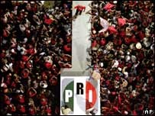
Foundation of the PRI
1920s conflicts with the Church, but beginnings of political stability
1930s Lazaro Cardenas’ populism
The corporatist model based on patronage
Co-opted sectors—peasants, unions, businesses
Controlled everything for 70 years

Slide 8
It was not until the colonization of Mexico by the Spanish and other European settlers that this practice seemed to disappear and be replaced by the encomienda system. The encomienda system was abolished by the Constitution of 1917, with the promise of restoring the ejido system. This, however, did not happen until Lázaro Cárdenas became president in 1934. The ejido system was introduced as an important component of the land reform program. The typical procedure for the establishment of an ejido involved the following steps: (1) landless farmers who leased lands from wealthy landlords would petition the federal government for the creation of an ejido in their general area; (2) the federal government would consult with the landlord; (3) the land would be expropriated from the landlords if the government approved the ejido; and (4) an ejido would be established and the original petitioners would be designated as ejidatarios with certain cultivation/use rights. Ejidatarios did not actually own the land, but were allowed to use their alloted parcels indefinitely as long as they did not fail to use the land for more than two years. They could even pass their rights on to their children.
According to the 1960 census, 23% of Mexico's cultivated land belonged to ejidos.
In 1991, Mexican President Carlos Salinas de Gortari eliminated the constitutional right to ejidos, citing the "low productivity" of communally owned land.^{[1]} Since then some of the ejido land has been sold to corporations, although most of it is still in the hands of farmers.

Slide 9
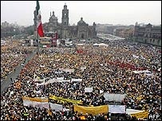
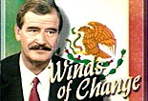
Decline of PRI
In 80’s PAN began making progress in Northern states and federal legislature
In 2000 and 2006 PAN won the presidency
Today PRI is the 3rd party behind PRD

Slide 10
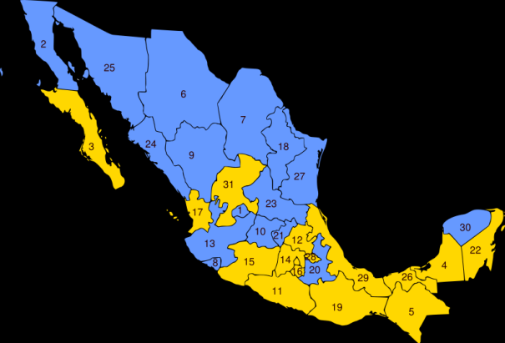
parties
PRI—in recent decades invoking the revolution, but technocrats favoring rationalization and free trade
PAN—North based conservative party, favoring trade
PRD—leftist party, strongest in the South

Slide 11
Economy— “the Miracle”
From 40-70s, PRI turns pro-growth
High growth, literacy and life expectancy grew, mortality dropped
But inequality also grew
Other Latin American countries improved social well-being more during these years

Slide 12
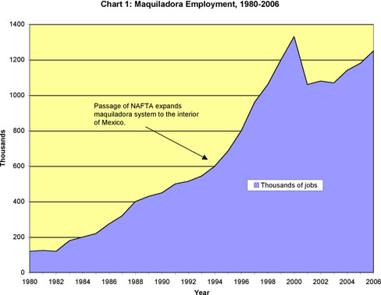
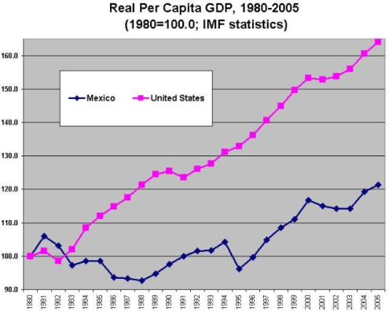
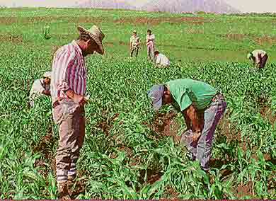
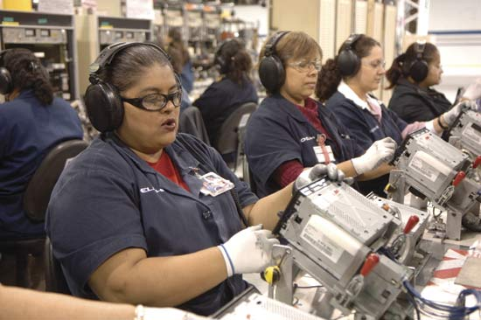
Neoliberalism and NAFTA
1994 NAFTA signed
Mexico further integrated into NA economy—US’s third biggest trading partner
Per capita GDP increased (slowly)
On the backs of poor farmers
Maquiladoras and competition from lower wage economies

Slide 13
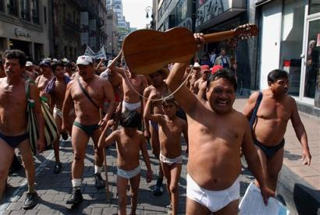
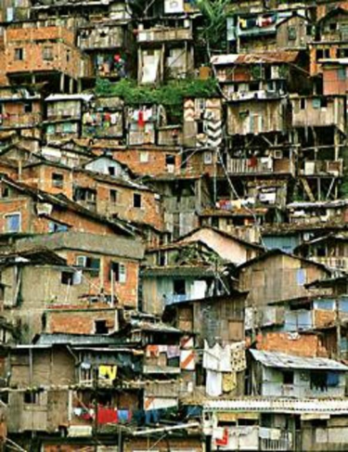
Poverty
Especially in rural areas, and in South
1990 more than 25% of such kids under 5 suffer severe malnutrition—and % had grown since 80s
Just over half kids finish elementary grades
Similar for homes with sewerage, piped water

Slide 14
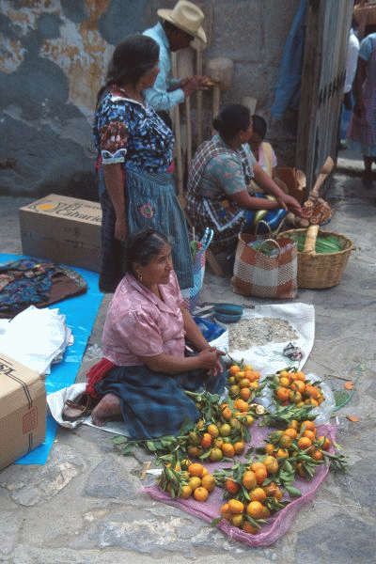
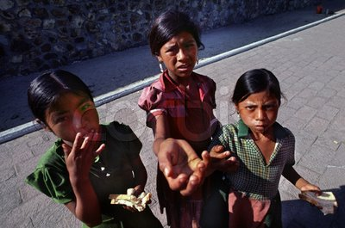
Ethnicity
Substantial indigenous population—especially in South
About 7% speak an indigenous language—Nahuatl, Maya, Zapotec, Mixtec, etc.
most speak Spanish too, but not all
Much higher rates of poverty, illiteracy etc.

Slide 15
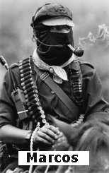
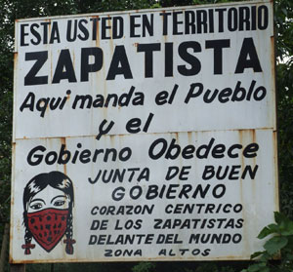
Zapatista Army of National Liberation
1/1/94 declare war on Mexican state
Anti-NAFTA and Neo-liberalism on behalf of rural and indigenous poor
Chiapas for Chiapacans—anarchistic democracy
Troops sent in, reconquered—but captured no leaders
negotiations resulting in some govt concessions
More media war than violent

Slide 16
remittances
In 90’s came to rival oil as source of foreign exchange

Slide 17
population

Slide 18
Congress
Chamber of Deputies and Senate
Constitution of 1917 makes them primary, but under PRI—a rubber stamp
Reforms of the 90s:
Mostly single member plurality, but substantial PR seats in both houses
Senate plurality seats: first place gets 2, second place 1
No one party can effectuate constitutional reform
Generated a three party system
One successive term rule—party discipline

Slide 19
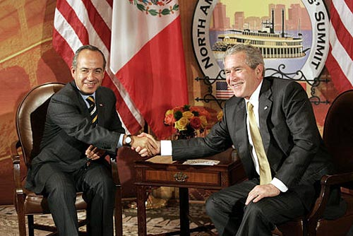
President
One term rule
Under PRI—total power, including “dedazo”
Now must contend with Congressional opposition

Slide 20
Court reform
‘94 Zedillo halved the size of Supreme Ct to 11
15 year terms instead of 6
2/3 Senate approval
But still takes 8 to overturn govt action

Slide 21
Social Policy
Relatively low spending on health and education—until late 90’s
In recent years—Seguro Popular—universal health by 2010
1997 Oportunidades—cash payments to moms for having kids in school, clinic visits, and health classes

Slide 22
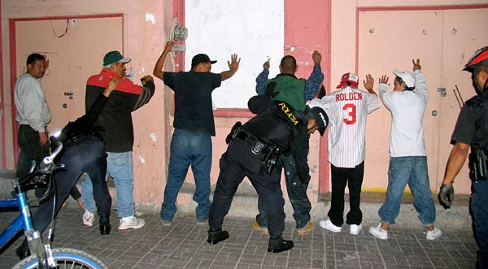
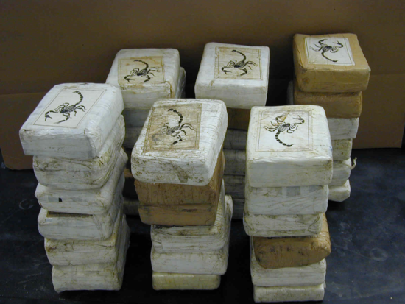
Crime
In some states crime rates doubled in 90s, and continue to grow
assault, kidnapping, murder, drug trade
Under-paid corrupt police
2008 Calderon brings in army to patrol cities like Juarez, Tijuana
crime

Slide 23
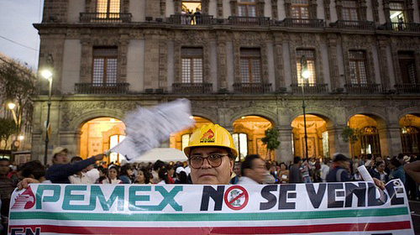
Pemex
Principal source of foreign exchange and govt revenue
Crumbling infrastructure, debt, and fields in decline
Calderon’s proposed reforms—increasing multi-national control

Slide 24
Mexico's oil has long been a source of national pride. Now, with reserves dwindling away, President Felipe Calderon has floated a controversial initiative to rescue the government oil giant, Pemex: allow foreigners to help the company drill for oil.

Slide 25
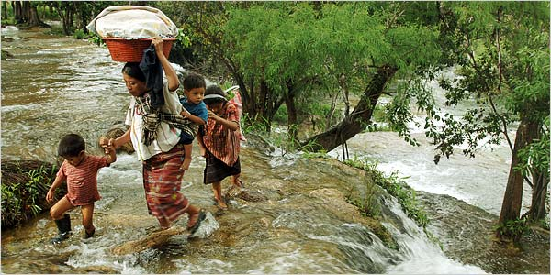
The border
Almost 1 in 10 Mexicans is in the US
Value of remittances second only to oil
Death in the desert

