Slide 1
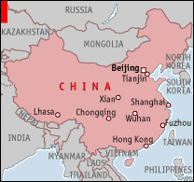
China

Slide 2
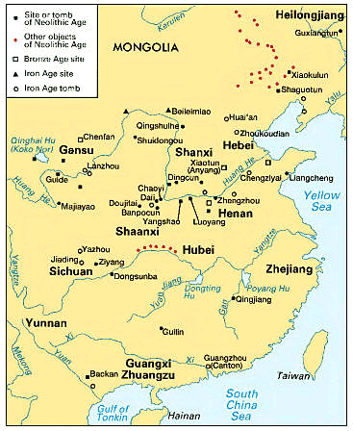
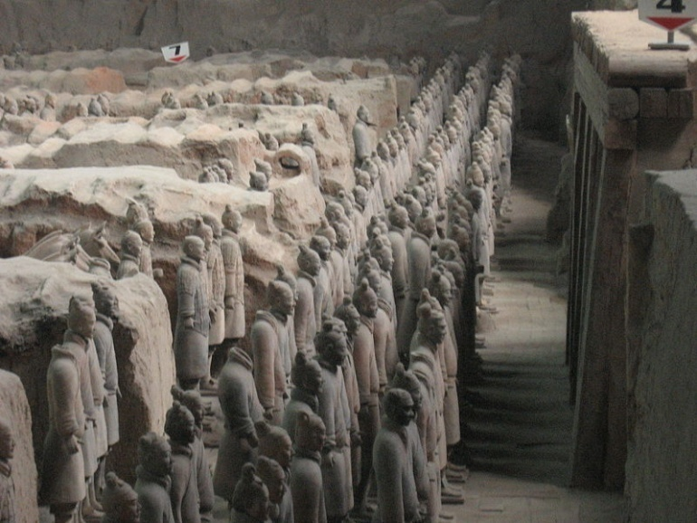
Early history
1500 BC early kingdoms emerge along Yellow River
By 200 BC Ch’in imperial dynasty emerges, creating Confucian state bureaucracy

Slide 3
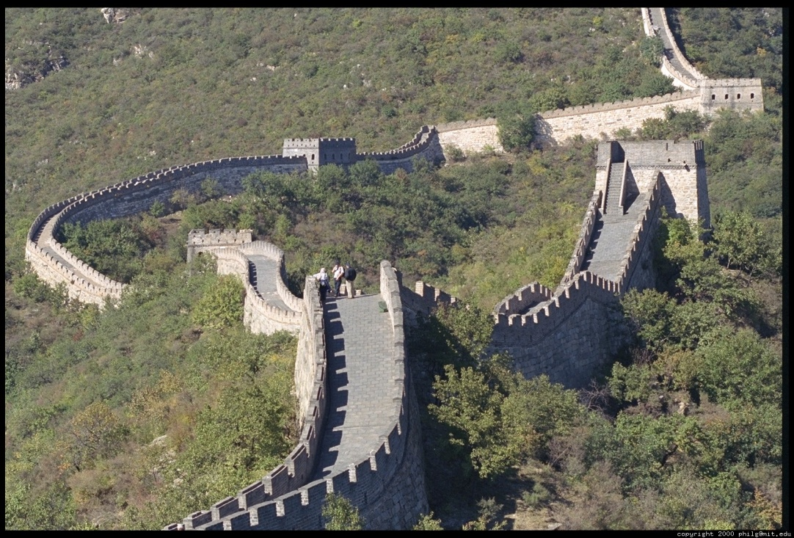
Great Divergence
During Ming Dynasty (c.1400-1600) China goes from being West’s technological equal and international trader to isolationist and less advanced

Slide 4
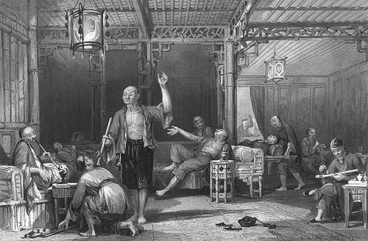
Colonialism and China
Chinese Emperors limited Western trade and contact to two ports
Increasingly weak dynasty tried to prohibit importation of opium
1830s-1850s China lost two “Opium Wars” to Britain
Forced to give up Hong Kong, allow missionaries, and all trade

Slide 5
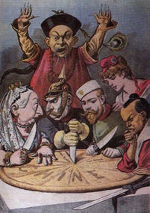
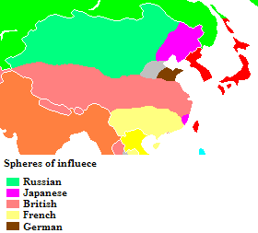
19th century humiliation of China
European powers and Japan carved up China into “spheres of influence” and treaty ports
US pushes for the “Open Door “ policy

Slide 6
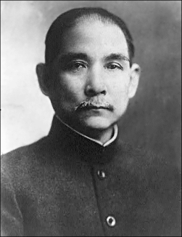
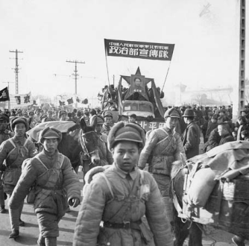
Foundation of the ROC and PRC
1911 Dr. Sun Yat-Sen and Nationalists overthrow Emperor, declare Republic
Nationalists and Communists unite against Warlords
After Japanese defeat, Communist with peasant support defeat Nationalists
1949 PRC proclaimed, nationalists flee to Taiwan

Slide 7
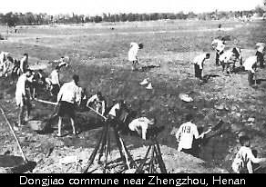
1958-60 “Great Leap Forward”
Mao orders collectivization, backyard foundries
20-30 million die through starvation

Slide 8
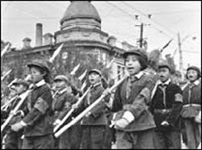
1966-76 “Cultural Revolution”
universities close, Red Guards run amok, “counter-revolutionaries” humiliated, purged, or killed
Great Leap Forward to Cultural Revolution

Slide 9
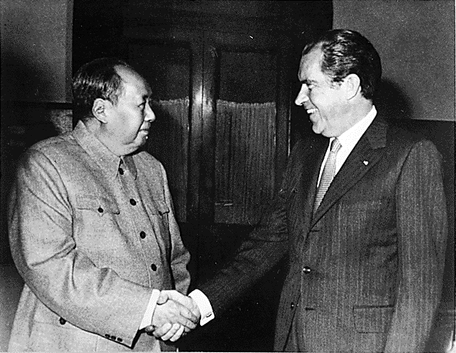
On the international front
Increased tensions with USSR
1972 Nixon goes to China

Slide 10
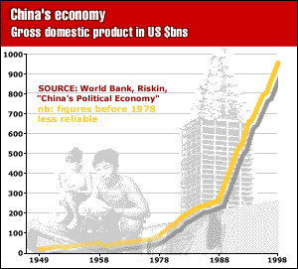
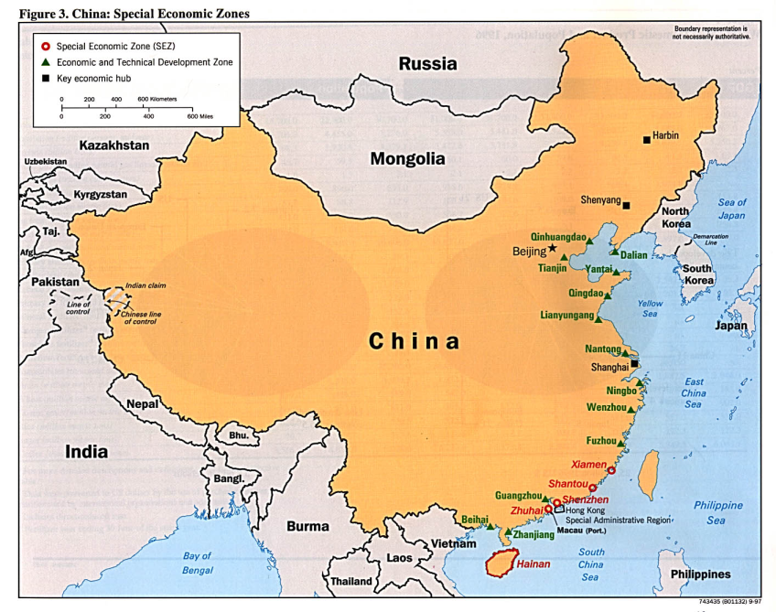
1978 period of (economic) liberalization begins under Deng Xiaoping
Family Responsibility system
Special Economic Zones

Slide 11
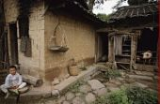
Wealth creeping to the West

Slide 12
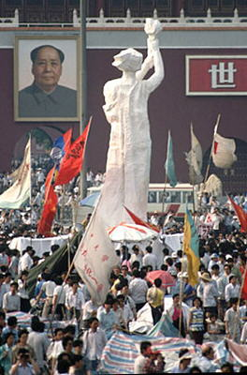
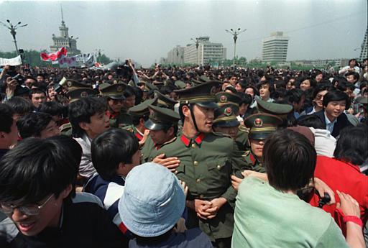
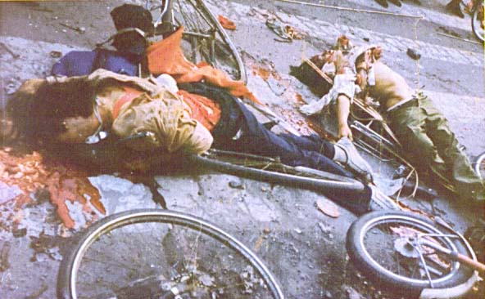
Tiananmen Square
Relative affluence and education lead to new demands
1989 100,000s throughout China demand reform
Suppressed by force after 6 weeks

Slide 13
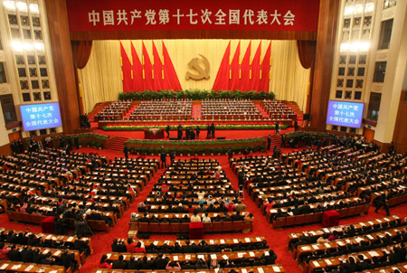
Govt
Parallel structures of legislature and govt, and party
Leg: National Peoples Congress
Selects government, including Premier
Party: National Party Congress
Selects Central Committee, which in turn selects top committees and General Secretary
Party most important

Slide 14
Baby steps towards democratization
Increasingly since the ‘80s, villages hold elections for local chiefs
A few townships have also elected leaders
But virtually all counties, cities, regions, and national leaders are appointed
In Shenzhen and other cities private citizens outside of the party are presenting themselves for office

Slide 15
Other aspects
Judiciary being reformed and professionalized
Growth of NGOs
For the year before the Olympics, foreign journalists allowed to travel freely (except in Tibet)
Some articles critical of local rule or pro democracy have been allowed, others have been on internet—but not challenging nat’l CCP
1000s of protests
Succession for Hu in 2012?

Slide 16
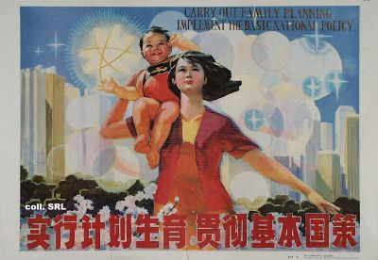
Population
Since 1979 one child policy
One child

Slide 17
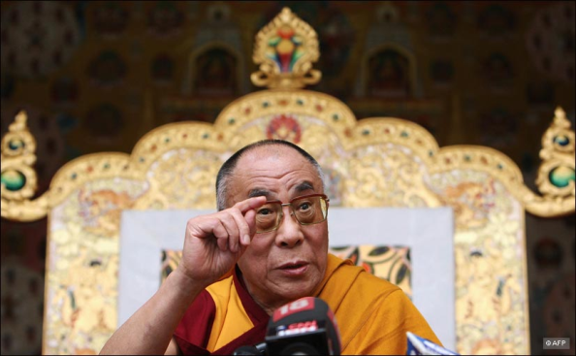
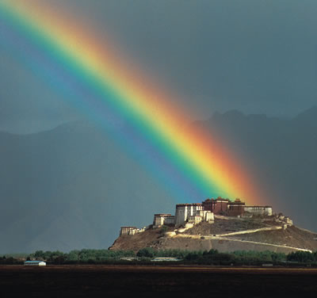
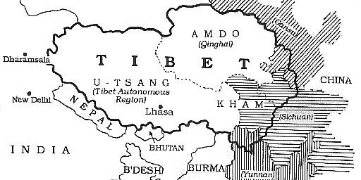
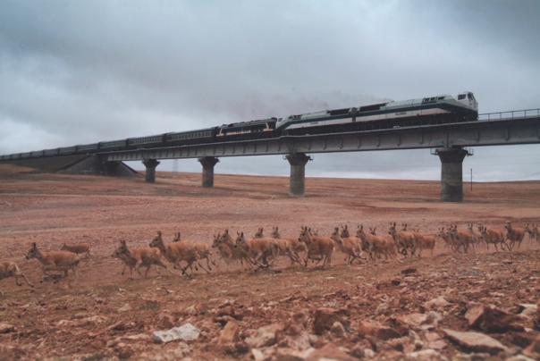
Tibet
Occupied by PRC since 1950
6 million Tibetans, almost as many Han
Uprisings and repression in 1959, 1989, …
100,000 exilees—mostly in India
Govt and Dalai Lama in exile—succession?
Schools built, income up, feudal order banned

Slide 18
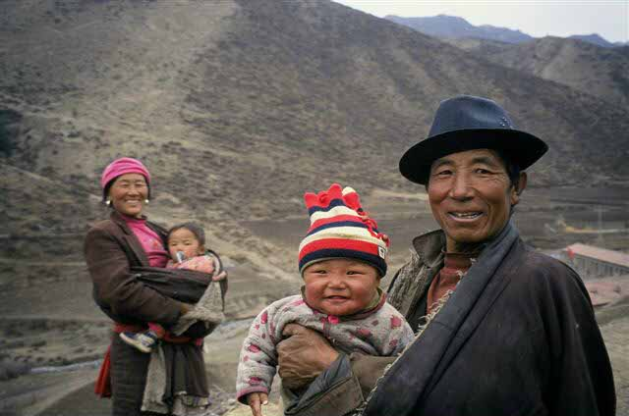
Differing Views
Pro-china
Pro-Tibet

Slide 19
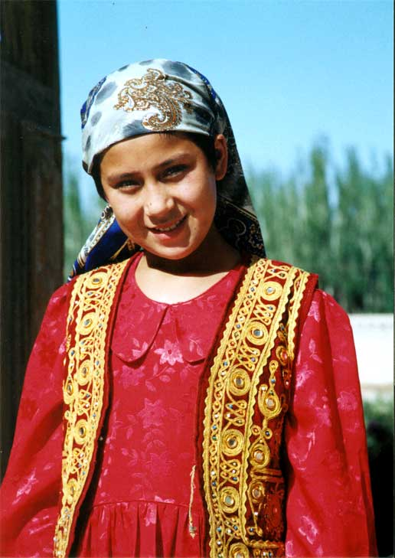
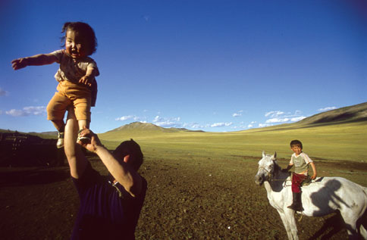
Mongolia (Inner), Manchuria, and Xinjiang
Outnumbered by Han
Resistance by muslim Uighurs in Xinjiang
All of PRC over 90% Han

Slide 20
Environment and growth
Huge costs in public health and productivity
Attempts to formulate an Enviro GDP
Lack of enforcement and accountability
Undermine continued growth and social stability

Slide 21
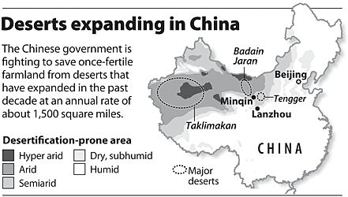
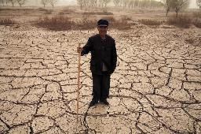
Water
Rising consumption and waste--priced far too low
80% sewage is untreated
Aquifers and ice caps disappearing
Gobi Desert spreading at rate of almost 2000 sq miles per year
desertification

Slide 22
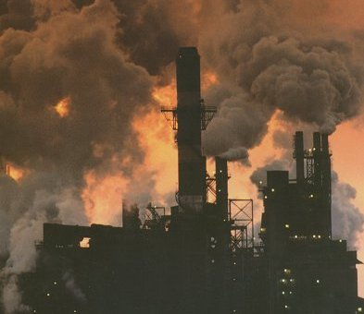
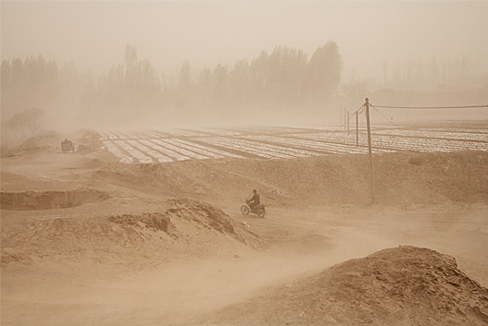
Air
Highest greenhouse emissions in the world—though not per capita
70% of power from coal—one new plant per week
By 2040 more cars than the US
pollution

Slide 23
Soil and food
Erosion and soil contamination
Agricultural production dropping
Demand growing

Slide 24
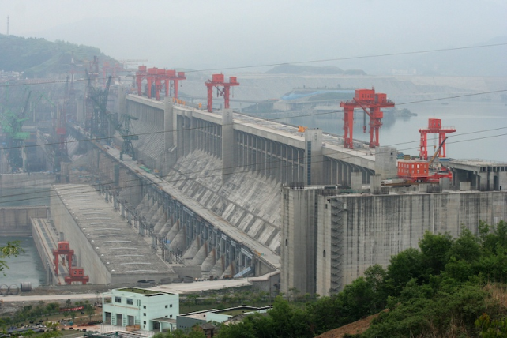
Dam building
Three Gorges—largest in the world
Over 1,000,000 displaced
Environmentally mixed

Slide 25
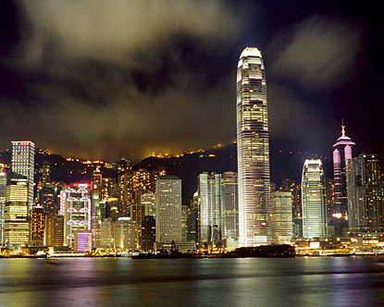
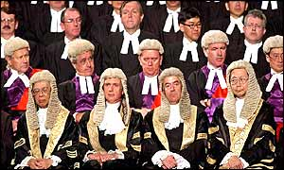
Hong Kong
Since ‘97—one country two systems until ‘47
China: defense, foreign affairs
Hong Kong: legal system, local govt, police
Executive selected by committee of sectors mostly loyal to Beijing and half legislative council popularly elected—for now

Slide 26
2003 half a million people participated in a march to voice disapproval of the Tung administration and the proposal to implement Article 23 of the Basic Law, (defining treason against PRC, etc) which had raised concerns over infringements on civil liberties. The proposal was later abandoned by the administration. In 2005, Tung submitted his resignation as chief executive. Donald Tsang, the Chief Secretary for Administration, was selected as chief executive to complete the term.

Slide 27
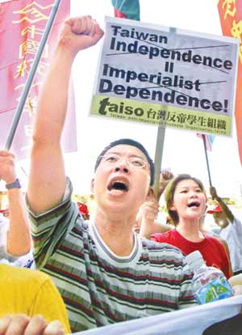
Taiwan
PRC considers it a province
Previous president talked of independence and seeking recognition
Present president , no

